Slide 1


PSYCHOLOGY
Chapter 10 MOTIVATION AND EMOTION
PowerPoint Image Slideshow

Slide 2

MOTIVATION AND EMOTION
Figure 10.1(credit: modification of work by Aaron “tango” Tang)
Emotions can change in an instant, especially in response to an unexpected event. Surprise, fear, anger, and sadness are some immediate emotions that people experienced in the aftermath of the April 15, 2013 Boston Marathon bombing.
What are emotions? What causes them? What motivated some bystanders to immediately help others, while other people ran for safety?

Slide 3
MOTIVATION
INTRINSIC VS EXTRINSIC MOTIVATION
THEORIES ABOUT MOTIVATION

Slide 4
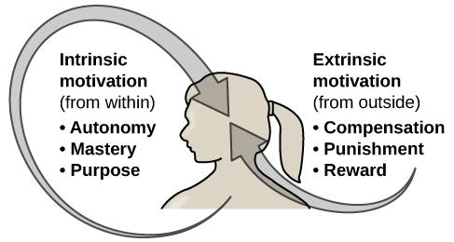
INTRINSIC VS EXTRINSIC MOTIVATION
Motivation – the wants or needs that direct behavior toward a goal.
Intrinsic motivation:
Arises from internal factors.
Behaviors are performed because they bring a sense of personal satisfaction.
Extrinsic motivation:
Arises from external factors.
Behaviors are performed in order to receive something from others.
Figure 10.2

Slide 5

INTRINSIC VS EXTRINSIC MOTIVATION
Overjustification effect – intrinsic motivation is diminished when extrinsic motivation is given.
Research suggests that when something we love to do, like icing cakes, becomes our job, our intrinsic and extrinsic motivations to do it may change. Once we are receiving an extrinsic motivation (like being paid) we may lose the motivation to do it just for enjoyment.
Other research suggests the opposite, that certain types of reinforcement, such as praise, can increase intrinsic motivation).
Explanations of differences:
Type of reinforcement.
Tangible rewards appear to decrease intrinsic motivation.
Intangible rewards appear to increase motivation.
Expectation of extrinsic reward – intrinsic motivation is more likely to decrease if extrinsic reward is expected.
Figure 10.3 (credit: Agustín Ruiz)

Slide 6
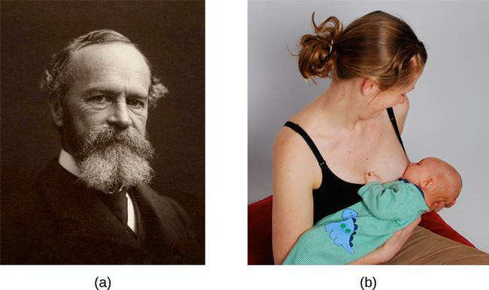
INSTINCT THEORY OF MOTIVATION
William James
Proposed the instinct theory of motivation, asserting that behavior is driven by instincts (which aid survival).
Proposed instincts included a mother’s protection of her baby, the urge to lick sugar, and hunting prey.
The theory received criticism for ignoring the role of learning in shaping human behavior.
In humans, instincts may include behaviors such as an infant’s rooting for a nipple and sucking.
Figure 10.4 (credit b: modification of work by “Mothering Touch”/Flickr)

Slide 7

DRIVE THEORY OF MOTIVATION
Drive theory proposed that the maintenance of homeostasis is important in directing behavior.
Deviations from homeostasis create physiological needs resulting in psychological drive states that direct behavior to meet the need and bring the system back to homeostasis.
Emphasizes the role that habits (pattern of behavior in which we regularly engage) play in behavioral responses → If a behavior successfully reduces a drive, we are more likely to engage in that behavior in future.
Hunger and subsequent eating are the result of complex physiological processes that maintain homeostasis.
Figure 10.5 (credit “left”: modification of work by “Gracie and Viv”/Flickr; credit “center”: modification of work by Steven Depolo; credit “right”: modification of work by Monica Renata)

Slide 8
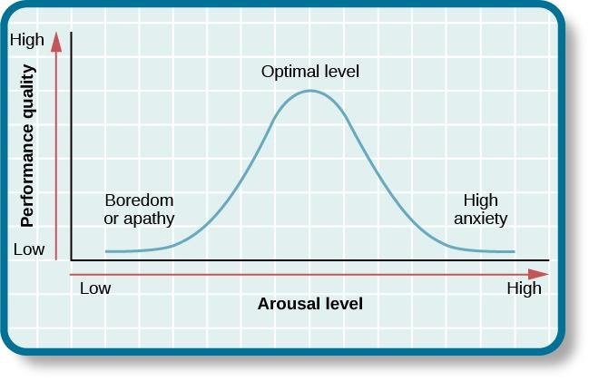
AROUSAL THEORY OF MOTIVATION
Arousal theories assert that there is an optimal level of arousal that we all try to maintain.
Underaroused →Become bored, seek stimulation.
Overaroused → Engage in behaviors to reduce arousal.
Research suggests that the optimal arousal level for performance is moderate arousal.
Figure 10.6
The concept of optimal arousal in relation to performance on a task is depicted here. Performance is maximized at the optimal level of arousal, and it tapers off during under- and overarousal.

Slide 9
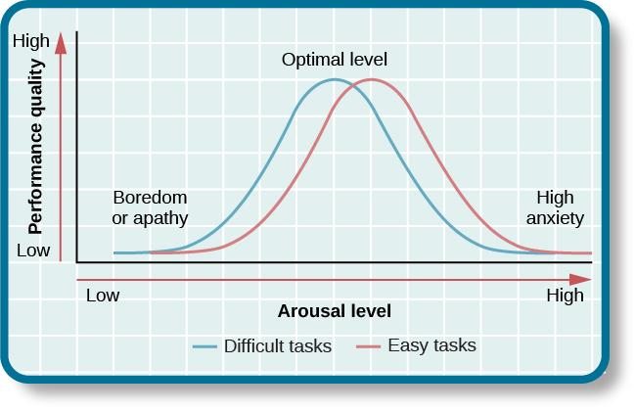
AROUSAL THEORY OF MOTIVATION
Yerkes and Dodson (1908)
The optimal arousal level depends on the complexity and difficulty of the task to be performed.
Yerkes-Dodson Law – task performance is best when arousal levels are in a middle range, with difficult tasks best performed under lower levels of arousal and simple tasks best performed under higher levels of arousal.
Figure 10.7

Slide 10
SELF-EFFICACY & SOCIAL MOTIVATION
Self-Efficacy
Self-efficacy – an individual’s belief in her own capability to complete a task.
Bandura:
Theorized that self-efficacy plays a role in motivating behavior.
Argues that motivation derives from expectations held about the consequences of behaviors.
Beliefs about our abilities will determine what we do and goals we set for ourselves.
Social Motives
Need for achievement – drives accomplishment and performance.
Need for affiliation – encourages positive interactions with others.
Need for intimacy – causes us to seek deep, meaningful relationships.

Slide 11

MASLOW’S HIERARCHY OF NEEDS
Abraham Maslow (1943)
Proposed a theory of motivation that spans the spectrum of motives including biological, individual and social.
One must satisfy lower-level needs before addressing the needs in higher levels.
A person without food, water and shelter is unlikely to be focused on relationships or what people think of them.
Figure 10.8

Slide 12
HUNGER & EATING
PHYSIOLOGICAL MECHANISMS
METABOLISM & BODY WEIGHT
OBESITY
EATING DISORDERS

Slide 13
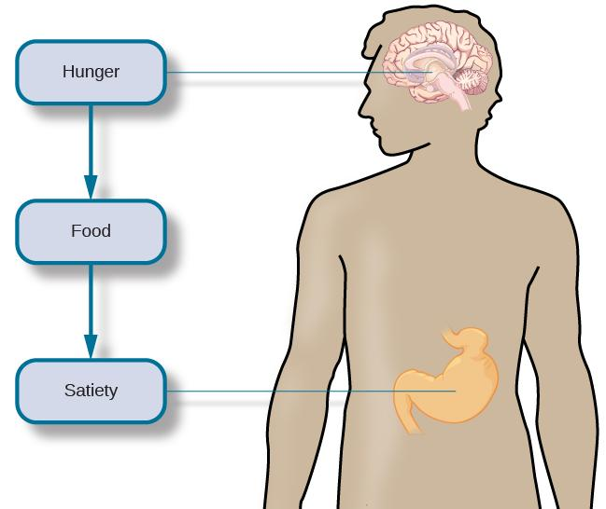
PHYSIOLOGICAL MECHANISMS
Hunger and eating are regulated by a complex interplay of hunger and satiety signals that are integrated in the brain.
Before Eating
Empty stomach → stomach contracts → hunger pangs and secretion of chemical messages that travel to the brain as a signal to initiation feeding behavior.
Low blood glucose levels → pancreas and liver generate chemical signals that induce hunger to initiate feeding behavior.
After Eating
Satiation – feeling of fullness and satisfaction causing eating behavior to stop.
Increase in blood glucose levels → pancreas and liver send signals to shut off hunger and eating.
Food passes through gastrointestinal tract → satiety signals are sent to the brain.
Fat cells release leptin (satiety hormone).
Figure 10.9

Slide 14
METABOLISM & BODY WEIGHT
Factors Affecting Body Weight
Gene-environment interactions.
Number of calories consumed versus number of calories burned in daily activity.
Metabolic rate
Metabolic rate – the amount of energy that is expended in a given period of time.
Various between individuals.
People with a high metabolic rate burn off calories more easily than those with lower rates of metabolism.
Regulation of Body Weight
Set-Point theory – each individual has an ideal body weight/set point, which is resistant to change.
Set point is genetically determined.
Efforts to move weight significantly from the set-point are resisted by compensatory changes in energy intake/expenditure.
Based on the observation that people’s weight generally fluctuates within a narrow margin.
Fails to account for the influences of social and environmental factors.

Slide 15
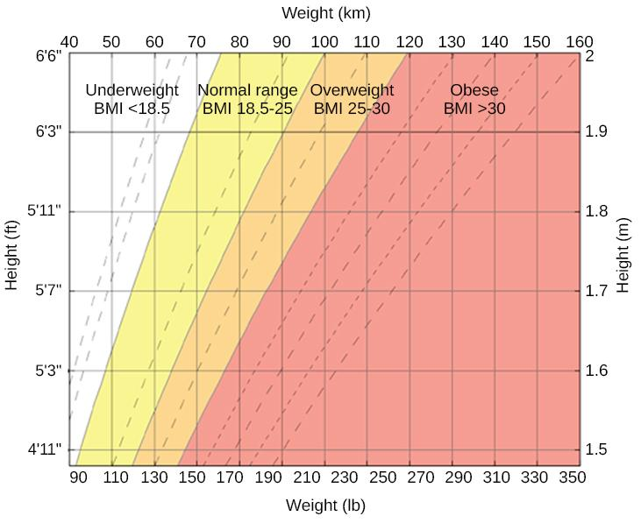
OBESITY
2/3 U.S. adults struggle with issues related to being overweight.
This chart shows how adult BMI is calculated. Individuals find their height on the y-axis and their weight on the x-axis to determine their BMI.
25 - 29.9 = overweight
Over 30 = obese
Over 40 = morbidly obese
Environmental Factors
As well as factors such as genetics and energy intake/expenditure, socioeconomic status and the physical environment can contribute to obesity.
May not feel comfortable walking or biking in a neighborhood with high crime rates which limits physical activity.
May not be able to afford healthy food options.
Figure 10.10

Slide 16
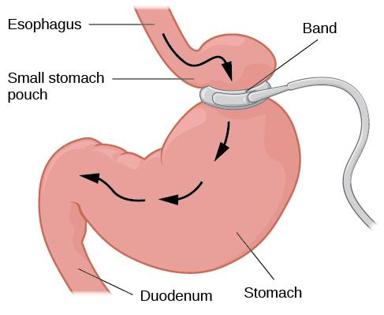
OBESITY
Health Risks
Cardiovascular disease
Stroke
Type 2 diabetes
Liver disease
Sleep apnea
Colon cancer
Breast cancer
Infertility
Arthritis
Weight Reduction
A combination of diet and exercise.
Bariatric Surgery:
Gastric banding surgery creates a small pouch of stomach, reducing the size of the stomach that can be used for digestion.
Figure 10.11

Slide 17
EATING DISORDERS
Bulimia Nervosa
Involves engaging in binge eating behavior, followed by attempts to compensate for the large amount of food consumed.
Compensation - includes vomiting, laxatives, excessive exercise.
Health consequences - can include kidney failure, heart failure, and tooth decay.
Psychological problems – depression, anxiety, increased risk for substance abuse.
Anorexia Nervosa
Maintenance of body weight below average through starvation and/or exercise.
Distorted body image - view themselves as fat even though they are not.
Health consequences – can include bone loss, heart failure, kidney failure, amenorrhea (cessation of menstrual period), reduced function of the gonads, in some cases death.
Psychological problems – anxiety disorders, mood disorders, substance abuse.

Slide 18

EATING DISORDERS
Caucasian females, ages 15-19, from Western societies are the most at-risk population.
Contributing Factors
Many blame the media for its messages of a thin ideal.
Genetics may also predispose people to these disorders.
Low self-esteem, other mental illnesses.
Life transitions, stress.
Experiences such as abuse and bullying.
Personality types (perfectionism).
Family issues.
Young women in our society are inundated with images of extremely thin models.
Figure 10.13 (credit: Peter Duhon)

Slide 19
SEXUAL BEHAVIOR
PHYSIOLOGICAL MECHANISMS
KINSEY’S RESEARCH
MASTER’S & JOHNSON’S RESEARCH
SEXUAL ORIENTATION
GENDER IDENTIY

Slide 20
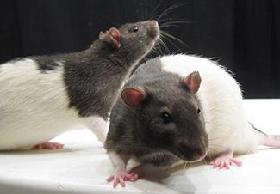
PHYSIOLOGICAL MECHANISMS
Hypothalamus
The hypothalamus plays an important role in motivated behavior, including sex.
Lesions to the medial preoptic area of the hypothalamus completely disrupt a male rat’s ability to engage in sexual behavior, but does not affect sexual motivation (he will still seek to gain access to sexually receptive females).
Suggests that the ability to engage in sexual behavior and the motivation to do so are mediated by different systems in the brain.
In humans:
Disorders that involve abnormal hypothalamic function are often associated with hypogonadism (reduced function of the gonads) and reduced sexual function.
Hormones secreted by endocrine glands (testosterone) influence sexual motivation and behavior.
Figure 10.14 (credit: Jason Snyder)

Slide 21
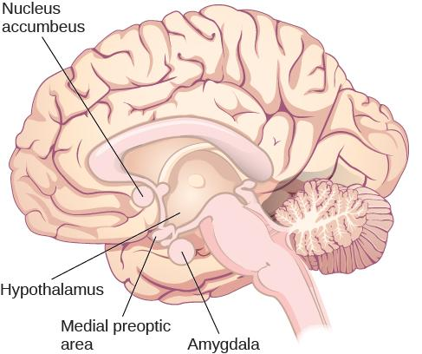
PHYSIOLOGICAL MECHANISMS
Amygdala and Nucleus Accumbens
Involved in motivation for sexual behavior, but do not affect the ability to engage in it.
Damage in rats results in a decreased motivation to engage in sexual behavior, while ability to do so is still intact.
Figure 10.15

Slide 22

KINSEY’S RESEARCH
In response to the lack of empirically-based information on sex during the late 1940’s, Dr. Alfred Kinsey initiated a large scale survey.
Behaviors thought to be rare were revealed to be much more common that previously thought.
Influential in shaping future research on human sexual behavior and motivation.
Findings:
Women are as interested and experienced in sex as men.
Both males and females masturbate, without negative health consequences.
Homosexual acts are fairly common.
Kinsey Scale – used to categorize an individuals sexual orientation.
In 1947, Alfred Kinsey established The Kinsey Institute for Research, Sex, Gender and Reproduction at Indiana University, shown here in 2011.
The Kinsey Institute has continued as a research site of important psychological studies for decades.
Figure 10.16

Slide 23
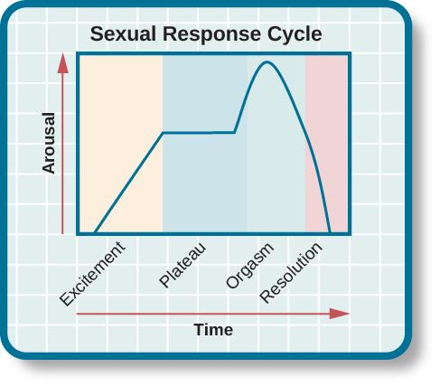
MASTERS AND JOHNSON’S RESEARCH
Conducted a study of physiological responses during sexual behavior.
Observed people engaging in sexual behaviors.
Measured physiological variables (e.g., blood pressure and respiration rate).
Measured sexual arousal (e.g. vaginal lubrication and penile tumescence).
Sexual Response Cycle
Excitement – arousal phase (erection, lubrication).
Plateau – Increased swelling and blood flow to labia minora, pre-ejaculatory fluid.
Orgasm – rhythmic contractions, ejaculation.
Resolution – return to unaroused state.
Figure 10.17

Slide 24

SEXUAL ORIENTATION
Sexual orientation – emotional and erotic attraction toward another individual.
A relatively stable characteristic of a person (not a choice).
Between 3% and 10% of the adult population identifies as homosexual.
What makes someone heterosexual vs homosexual?
Previously thought to be caused by different socialization and familial experiences but research shows that those experiences can be very similar in homosexuals and heterosexuals.
Genetic and biological mechanisms - research has found differences in brain structure and function between heterosexuals and homosexuals.
Figure 10.18 (credit: Till Krech)

Slide 25
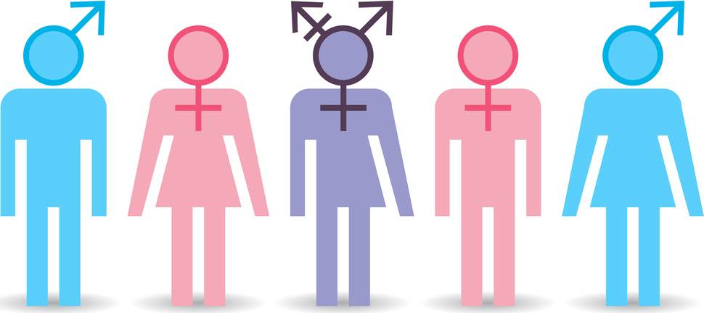
GENDER IDENTITY
Gender identity – one’s sense of being male or female.
In most cases, our gender identities correspond to our biological sex but not always.
Gender dysphoria – diagnosis describing individuals who do not identify as the gender that most people would assume they are.
Must persist for at least six months.
Must result in significant distress or dysfunction to meet diagnosis criteria.
Transgender hormone therapy – use of hormones to make one’s body look more like the opposite-sex.
(Credit: The Odyssey Online)

Slide 26
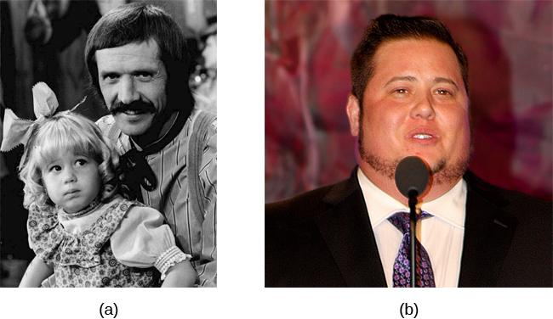
GENDER IDENTITY
Chaz Bono, a transgender male, is a well-known person who transitioned from female to male. (a) In the 1970s, the world knew Chaz as Chastity Bono, the daughter of the famous entertaining duo Sonny and Cher; here young Chastity is pictured with Sonny. (b) Later in life, Chaz transitioned to align his physical body with his gender identity.
Figure 10.19 (credit b: modification of work by “dvsross”/Flickr)

Slide 27
EMOTION
THEORIES OF EMOTION
THE BIOLOGY OF EMOTIONS
FACIAL EXPRESSION & RECOGNITION OF EMOTIONS

Slide 28
EMOTION VS MOOD
Mood
Prolonged, less intense, affective state.
Does not occur in response to something we experience.
May not be consciously recognized or intentional.
Emotion
A subjective state of being that we often use to describe our feelings.
Relatively intense and occurs in response to an experience,
Consciously experienced and intentional.
Components of emotion – physiological arousal, psychological appraisal, and subjective experiences.
Informed by experiences, backgrounds, and cultures.

Slide 29
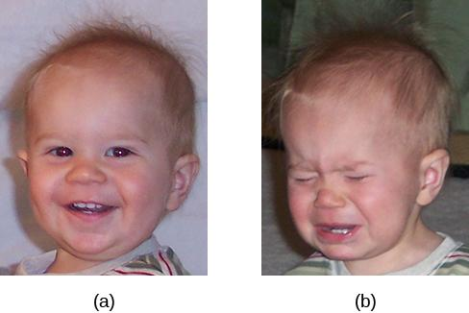
EMOTION
Toddlers can cycle through emotions quickly, being (a) extremely happy one moment and (b) extremely sad the next.
Figure 10.20 (credit a: modification of work by Kerry Ceszyk; credit b: modification of work by Kerry Ceszyk)

Slide 30
THEORIES OF EMOTION
James-Lange Theory
Emotions arise from physiological arousal.
See snake → heart and respiration rate increase (physiological arousal) → feeling of fear.
Cannon-Bard Theory
Physiological arousal and emotional experience occur simultaneously, yet independently.
Occur at the same time but are independent of each other.
See snake → physiological arousal AND feel fear.
Empirical Findings
Individuals with spinal cord injuries (incapable of receiving autonomic feedback) could still experience emotion but in some it was less intense.
Suppression of facial expression of emotion lowered the intensity of emotions experienced.
These findings suggest that physiological arousal is not necessary to experience emotion but increases the intensity.

Slide 31
THEORIES OF EMOTION
Schachter-Singer Two-Factor Theory
Emotions are composed of two factors: physiological and cognitive.
Physiological arousal is interpreted in context leading to the emotional experience.
See snake → physiological arousal and cognitive assessment of situation labels arousal as fear → experience fear.
Believed physiological arousal is very similar across the different types of emotion, making cognitive assessment important.
  Palms sweating, heart racing, increased respiration rate (could be scared or nervous).
Lazarus’ Cognitive-Mediational Theory
Emotions are determined by our appraisal of the stimulus.
Unlike the Schachter-Singer model, the appraisal occurs before the label.
Appraisal is immediate and unconscious.

Slide 32
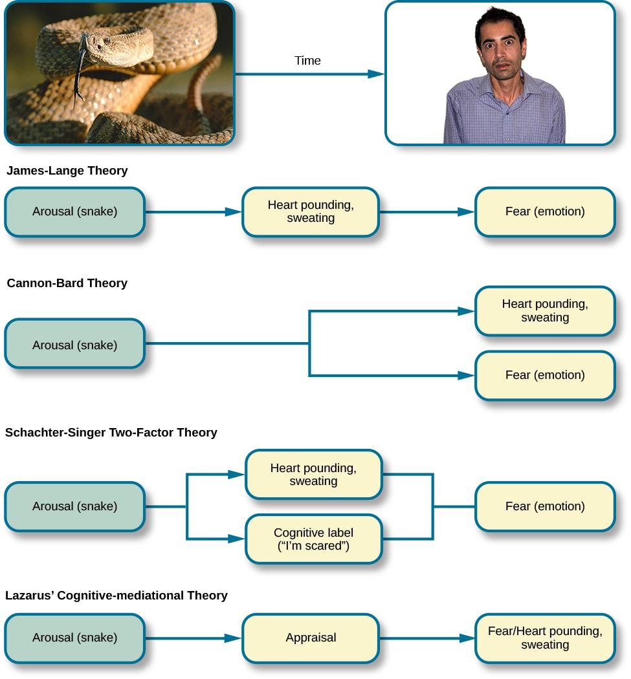
THEORIES OF EMOTION
Figure 10.21 (credit “snake”: modification of work by “tableatny”/Flickr; credit “face”: modification of work by Cory Zanker)

Slide 33

THE BIOLOGY OF EMOTIONS
The Limbic System
Involved in mediating emotional response and memory.
Hypothalamus – involved in activation of the sympathetic nervous system (part of an emotional reaction).
Thalamus – sensory relay center, neurons project to both the amygdala and higher cortical regions for further processing.
Amygdala – plays a role in processing emotional information and sending it on to cortical structures.
Hippocampus – integrates emotional experience with cognition.
Figure 10.22

Slide 34
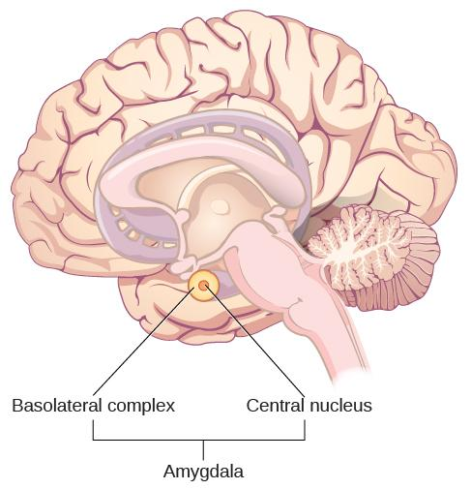
AMYGDALA
The amygdala has been a primary target of research concerning the biological basis for emotions, especially fear and anxiety.
The amygdala is composed of various subnuclei including the basolateral complex and central nucleus.
Basolateral Complex:
Has dense connections with a different sensory areas of the brain.
Critical for classical conditioning and attaching emotional value to learning processes and memory.
Central Nucleus:
Involved in attention.
Has connections with the hypothalamus and various brain stem areas to regulate the autonomic nervous system and endocrine systems’ activities.
Figure 10.23

Slide 35
FACIAL EXPRESSION AND RECOGNITION
OF EMOTIONS
Cultural display rule – culturally specific standards that govern the types and frequencies of displays of emotions that are acceptable.
Individuals from the U.S. express negative emotions like fear, anger and disgust both alone and in the presence of others.
Individuals from Japan only express these emotions while alone.
Despite varying cultural display rules, recognition and production of facial expressions of certain emotions are universal.

Slide 36
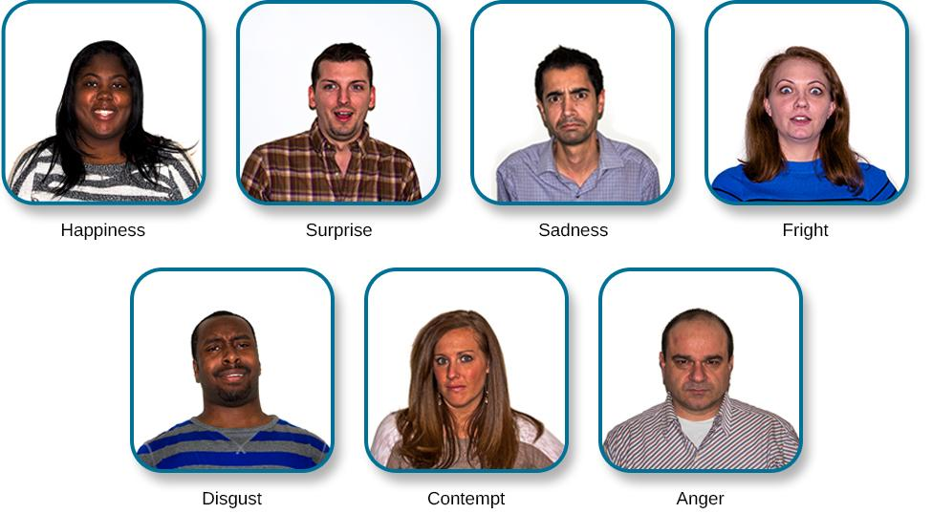
SEVEN UNIVERSAL FACIAL EXPRESSIONS
OF EMOTION
Figure 10.24 (credit: modification of work by Cory Zanker)

Slide 37
FACIAL FEEDBACK HYPOTHESIS
Does smiling make you happy? Or does being happy make you smile?
Facial Feedback Hypothesis – facial expressions are capable of influencing our emotions.
Support:
Depressed individuals reported less depression after paralysis of their frowning muscles with Botox injections.
Emotional stimulus → facial expression → physiological arousal → emotional experience.

